Slide 1

TU-Ilmenau - Game Development - WS-20/21
PLAY BALL
IN VR
Group 9:
Munim Ahmed
Sadia Ferdous Snigdha
Syed Muhammad Saleh Arfi
Nabeel Asim
03.02.2021
1

Slide 2
Solution to your boredom
Are you frustrated? Bored? Limited to your room due to corona?
Well there's a solution to it and it's FUN!
Try Play Ball and enter into a virtual realm where you can squish, kill and smash different creatures
You can relief yourself of the boredom, frustration and even anger!
Teleport yourself in to another world, all you need to do is grab a ball and start smashing.
Get rid of the spooky creatures, clean the room and fulfill yourself with joy!
2

Slide 3
FEATURES
The game contains a virtual 3D room including moving characters as well as fixed objects
Different animal characters including insects are present in the room
The main goal is to pick up the ball and throw it at the targeted character
32

Slide 4
FEATURES
Earn scores by throwing the ball at the insects/animal characters
If the ball collides with any death object the game will restart, hence no scores will be obtained
Notification text will be generated after clearing each target and also when the ball collides with the fixed objects/character
44

Slide 5
VR Environment
User Interface -> Game menu, Score Counter
Room Environment -> Furniture/plants/electronics
Target Objects -> Insects/animal characters
Death Objects -> Human characters/rotating object
Weapon -> Ball (rolling, throwing, smashing)
5

Slide 6
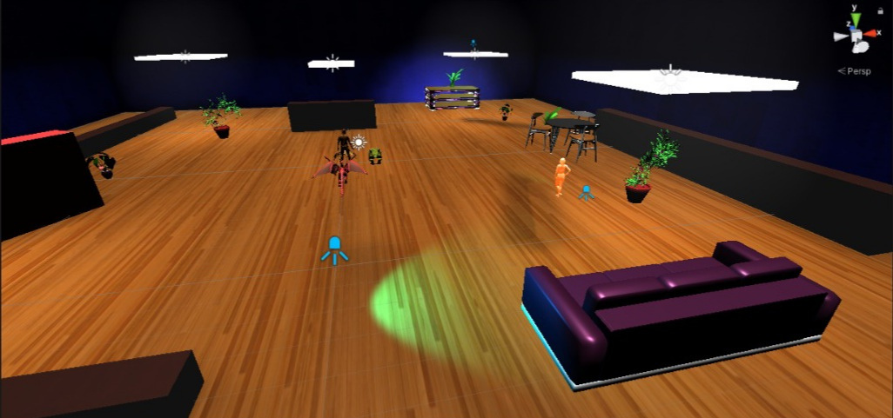
Room environment
6

Slide 7
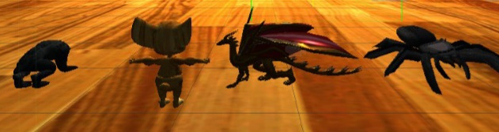
Target Objects
7

Slide 8
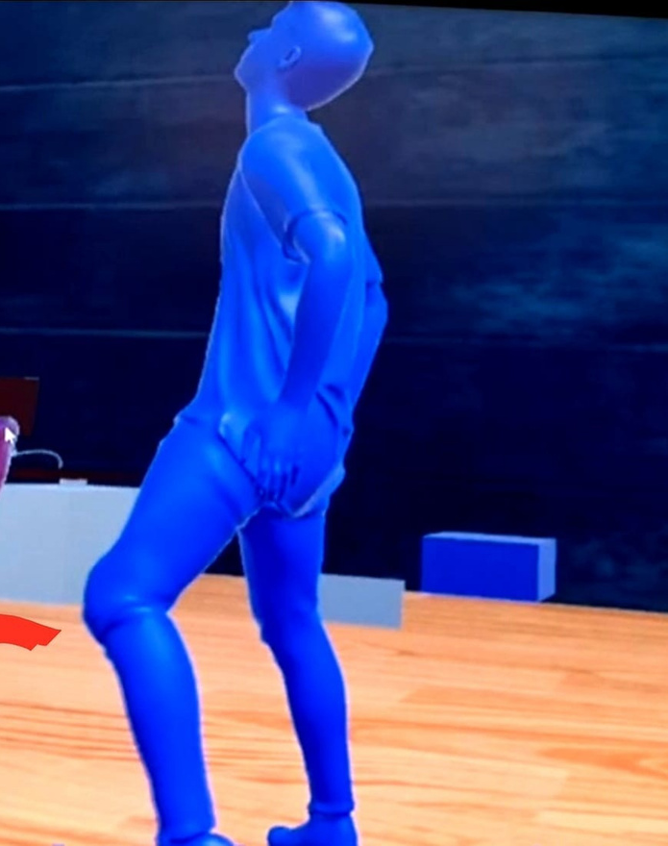
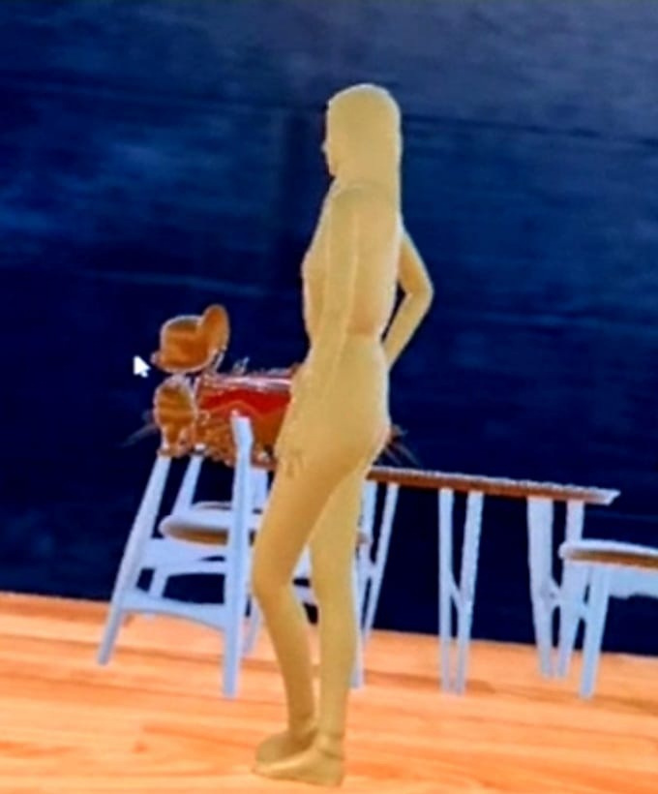
Death Objects
8

Slide 9

Weapon
9

Slide 10
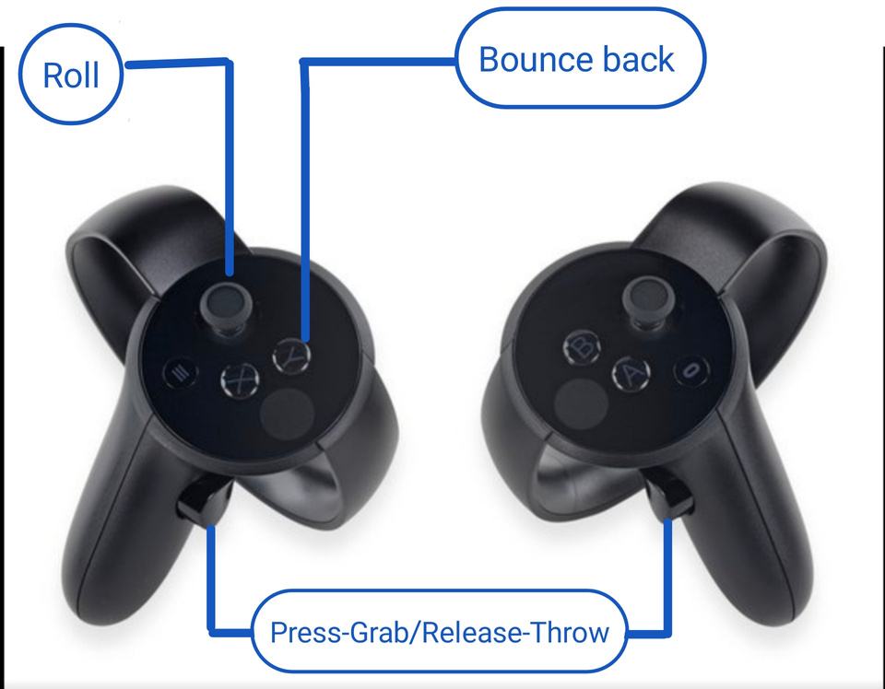
Oculus rift controllers
11

Slide 11
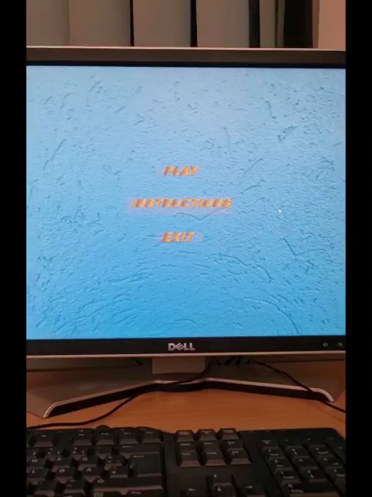
Game Play
12

Slide 12
Thanks for listening
13

Slide 13
Contact Info
munim.ahmed@tu-ilmenau.de
nabeel-asim.sheikh@tu-ilmenau.de
sadia-ferdous.snigdha@tu-ilmenau.de
syed-muhammad-saleh.arfi@tu-ilmenau.de
14

